Slide 1
Pete’s Pizzeria Case Study & Introduction to Six Sigma
Dr. John Draper
Assistant Professor – Clinical
Fisher College of Business

Slide 2
Teaching Objectives
Introduce DMAIC as a mechanism to solve business problems.
Provide instruction on a limited set of DMAIC tools.
Provide DMAIC tollgate questions that should be answered in each phase of a project.

Slide 3
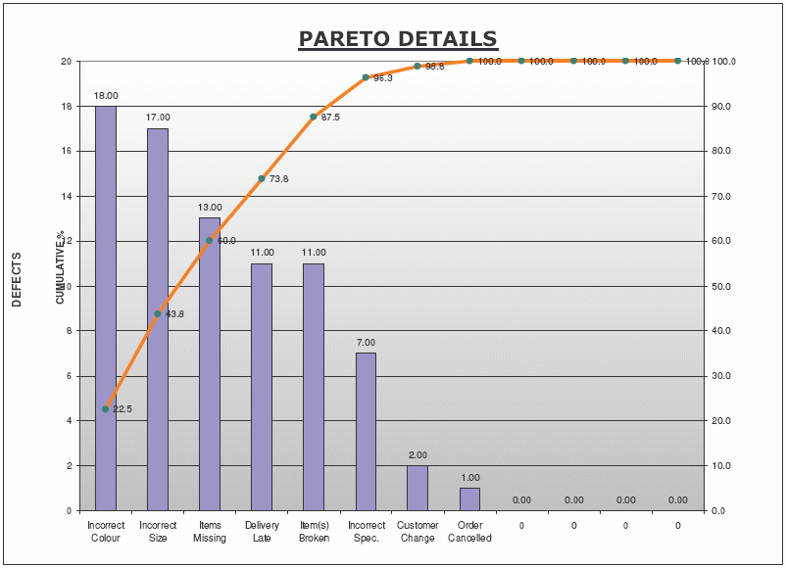
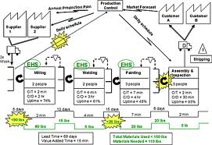
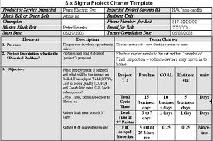

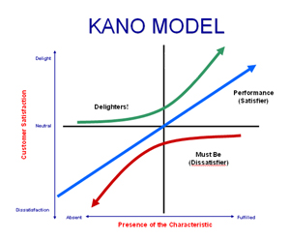
Define phase
Plan
Do
Study
Adjust
D
Identify business opportunities
Understand the current process
Develop project charter
Develop team and stakeholder plan
Listen to the voice of the customer

Slide 4
Define Phase – Tollgate Questions
What are we trying to accomplish (Mission)?
Who is the customer and what output is important to the customer? What are the critical-to-quality characteristics?
Why are we working on this project? What is the business case for this activity?
What is the project scope? Is the project broad enough to be important, but narrow enough to be do-able?

Slide 5
Define Phase – Tollgate Questions
How does the current process flow? What are the current inputs into the process?
What resources are required to complete the project? Who is going to work on the project?
When must the project be completed?

Slide 6
Define Phase – Tools Applied
Voice of the Customer
- Surveys
- Affinity Diagram
- Kano Model
- Critical to Quality Tree
Understand the Process (Go to gemba!)
- SIPOC
- Process Map
- Value Stream Map

Slide 7

Six Sigma Case Study Pete’s Pizzeria

Slide 8
Pete’s Pizzeria Business Case
Pete’s Pizzeria has been in the pizza delivery business for over 30 years. Recently, a new competitor entered the market guaranteeing delivery within 30 minutes of the order. The new competitor was beginning to take business away from Pete and he wondered if he should offer a delivery guarantee of his own.

Slide 9
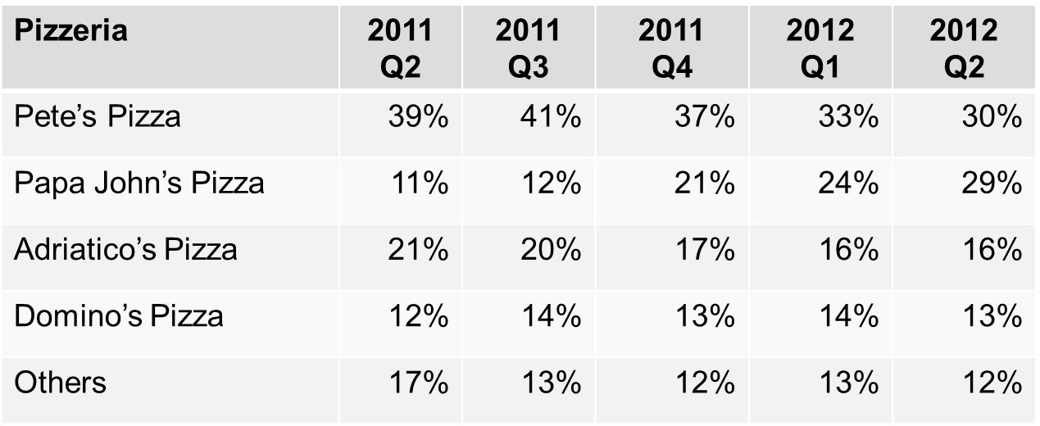
Pete’s Pizzeria Market Share

Slide 10
Pete’s Pizzeria Income Statement
 | 2011 Q3 | 2011 Q4 | 2012 Q1 | 2012 Q2
Total Revenue | $299,214 | $284,253 | $255,828 | $232,803
Expenses:
Cost of Goods Sold | 140,630 | 133,599 | 120,239 | 109,417
Selling and general | 62,835 | 59,693 | 53,724 | 48,889
Interest expense | 5,984 | 5,685 | 5,117 | 4,656
Income tax expense | 29,921 | 28,425 | 25,583 | 23,280
Total expenses | 239,371 | 227,402 | 204,662 | 186,242
Net Income | $59,843 | $56,851 | $51,166 | $46,561
Revenue declining since Q4 2011
COGS is 47% of revenue throughout

Slide 11
Define Phase – Business Case
To develop the business case, answer the following questions:
What is the purpose, the business reason for choosing this issue?
What specific performance measure needs to be improved?
What is the strategic, operational, historical or organizational context of the situation?
Be concise – draw pictures

Slide 12

Define Phase – Business Case Exercise
With your team take 5 minutes to develop the business case for this project.
___________________________________
___________________________________
___________________________________
___________________________________

Slide 13
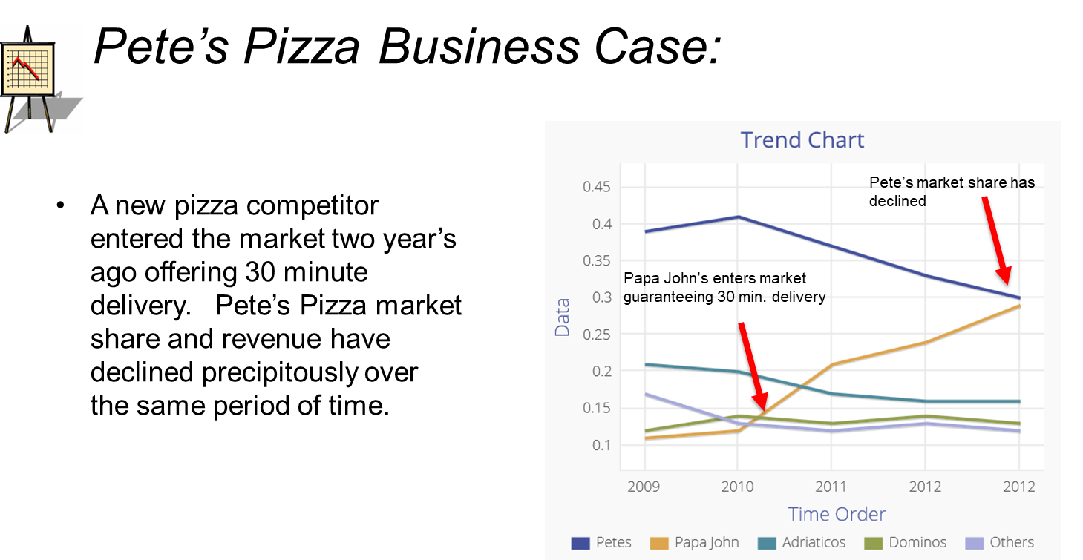
Define Phase – Business Case Exercise

Slide 14
Pete’s Pizzeria Business Case
Pete, with the help from his weekend operations manager Lauren, created a short survey for his customers to complete so he could better understand their preferences regarding how quickly they wanted their pizza delivered.

Slide 15
Pete’s Pizzeria Business Case
The sample of 500 revealed that on average Pete’s customers wanted their pizza in 29 minutes or less. A shocking 15% of Pete’s customer’s would not recommend them to a friend because of slow service!
Pete became worried about losing more customers to the competition and wanted to offer a delivery guarantee.

Slide 16
Pete’s Pizzeria Business Case
“I usually order pizza for any speaker series or any such event in college. We need it delivered on time and complete.”- President, Student Business Club
“We have been in this strategy implementation meeting for the past few hours and it’s already 6:45 PM. Why don’t we order pizza for dinner?”- Project Manager, AB Logistics
“God! I am too tired again tonight to cook. Will have to call up the pizza guys. Will save me time and hassle.”- Computer Science PhD student at OSU
“Wow, this basketball game went into double overtime. Let’s celebrate with some Pizza. It needs to be here quickly.” Joe Smith, avid basketball fan
Open Pete’s Customer Survey to see more results

Slide 17
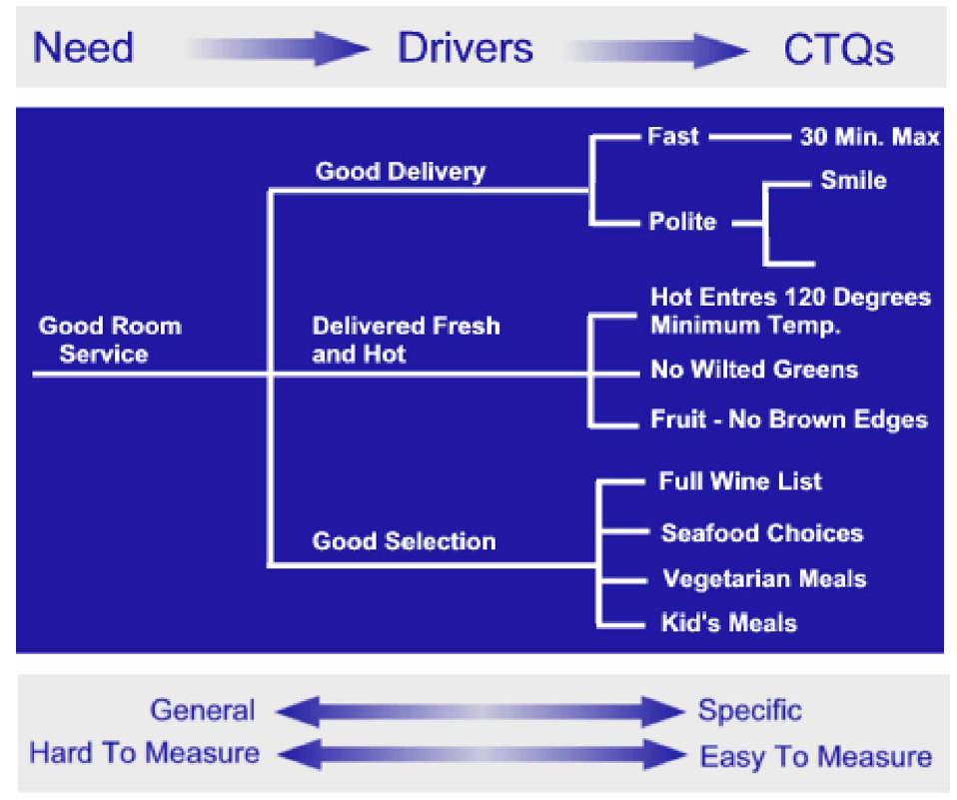
Define Phase – Critical to Quality Tree
Identify customers and translate the customer needs into Critical to Quality Characteristics.

Slide 18
Define Exercise – Critical to Quality Tree
With your team take 15 minutes to develop a Critical to Quality Tree:
Need
Driver
CTQ
Metric
Prompt Pizza
Delivery

Slide 19
Define Phase – CTQT Example
With your team take 15 minutes to develop a Critical to Quality Tree:
Need
Driver
CTQ
Metric
Availability of ingredients
Reorder point for each ingredient
Pizza making
Availability of cooks
Sun-Thurs→ 2
Fri-Sat→4
Prompt Pizza Delivery
Reliability of drivers
Availability of drivers
5 drivers: On time? Absent?
Day and time of delivery
How long did delivery take?
Traffic conditions

Slide 20
Pete’s Pizzeria Business Case
To offer a guarantee of 29 minutes or less, Pete’s average delivery time would have to be 25 minutes or less.
This would limit the amount of “free pizzas” under the guarantee to about 5% of all deliveries, the breakeven point for the promotion.

Slide 21
Pete’s Pizzeria Business Case
Lauren, the operations management student that worked for Pete as his weekend manager, convinced Pete that before he offered the delivery guarantee he should understand the capabilities of his process.
Lauren had been studying value stream mapping in her operations management class at school and thought mapping the pizza making process might be useful to help Pete understand more about his processes.

Slide 22
Pete’s Pizzeria Business Case
Lauren pulled a team of employees together and assigned one team member to analyze the demand data for pizzas. She remembered from her operations management class that
Takt time = available time/customer demand
was very important to understanding how often Pete’s should make a pizza. However, she wasn’t sure which demand data she should use.
Look in Data for Pete’s Pizza.xls for sales data

Slide 23
Pete’s Pizzeria Business Case
Lauren and her team decided to follow a pepperoni pizza on Friday night.
After an order is placed by phone. It takes approximately 60 seconds to take the order.
After the order is placed, the order is prepped by two cooks (four on Friday/Saturday). It takes about 90 seconds to prep a pizza.

Slide 24
Pete’s Pizzeria Business Case
The pizza is then put in the oven on a conveyor belt. The oven holds 16 pizza’s and it bakes for 12 minutes.
One of the five available drivers, local college students, takes the completed pizza in a heat-insulated bag to the customer.
Pete’s delivery service operations run every day from 4 p.m. to midnight.

Slide 25
Pete’s Pizzeria Business Case
Once the pizza is completed a cook removes the pizza from the oven, then slices and boxes the pizza. This takes 60 seconds.
One of the five available drivers, local college students, takes the completed pizza in a heat-insulated bag to the customer. Average trip was around 9 minutes.
The day that Lauren watched the process there were 4 pizza’s waiting for delivery.

Slide 26
Pete’s Pizzeria Business Case
Lauren and her team followed a pepperoni pizza on Friday night and collected the following data:
Take Order – 60 seconds
Prep Pizza – 90 seconds
Bake Pizza – 12 minutes
Box – 60 seconds
Waiting for Delivery – 4 pizza’s waiting, 3.5 min
Deliver Pizza – 9 minutes to customer

Slide 27
Pete’s Pizzeria Business Case
Lauren observed that approximately 10% of the pizza’s took longer than 29 minutes to deliver. She also observed that several of the driver’s were confused on directions and may have taken a longer time to deliver the pizza’s.

Slide 28
Define Phase – SIPOC Defined
A process map: Suppliers, Inputs, Core Process, Outputs, Customers
High-level visual representation of a process or value stream
Identifies process inputs, thus used as the first cut at identifying potential key process inputs (KPIs)

Slide 29
Define Phase – SIPOC Example

Slide 30
Define Phase – SIPOC Exercise
With your team take 15 minutes to build a SIPOC Map. Process steps are:
Phone in the order
Prep Pizza
Bake Pizza
Box
Delivery Pizza

Slide 31
Define Phase – SIPOC Exercise
SUPPLIERS | INPUTS | PROCESS | OUTPUTS | CUSTOMER
 |  | Take order over the phone
 |  | Prep pizza
 |  | Bake pizza
 |  | Box pizza
 |  | Deliver pizza

Slide 32
Define Phase – SIPOC Exercise
SUPPLIERS | INPUTS | PROCESS | OUTPUTS | CUSTOMER
Utility computer | Phone line Associate Menu Computer system | Take order over the phone | Order Address Payment information | Pizza prepper
Order taker Ingredient supplier refrigerator | Ingredients – cheese, sauce,etc pans Order Associate | Prep pizza | Prepped pizza | Pizza boxer
Equipment supplier Utility | Oven electricity | Bake pizza | Baked pizza | Pizza boxer
Box supplier | Baked pizza Boxes Pizza cutter | Box pizza | Boxed pizza | driver
 | Pizza Address Billing information Delivery vehicle | Deliver pizza | Delivered pizza | customer

Slide 33
Define Phase – Value Stream Mapping
Links material and information flow for the full value stream
Includes critical process data to make waste visible
Summarizes actual lead times and process times
Establishes a common language
Provides a blueprint for improvement
Exposes opportunities for Waste Elimination and Variation Reduction projects
Information Flow
Material Flow
Equally applicable to operational and transactional
processes

Slide 34
Define Phase – Value Stream Mapping
Customer
Main Fulfillment Processes
Suppliers
Information Control Center Production Control
Lead Time Calculation
3
4
1
2
5
VSM is a visual depiction of how these five elements
are (or are not) interconnected

Slide 35
Define Phase – Value Stream Mapping
With your team take 20 minutes to build a Value Stream Map. Process steps are:
Phone in the order
Prep Pizza
Bake Pizza
Box Pizza
Delivery Pizza

Slide 36
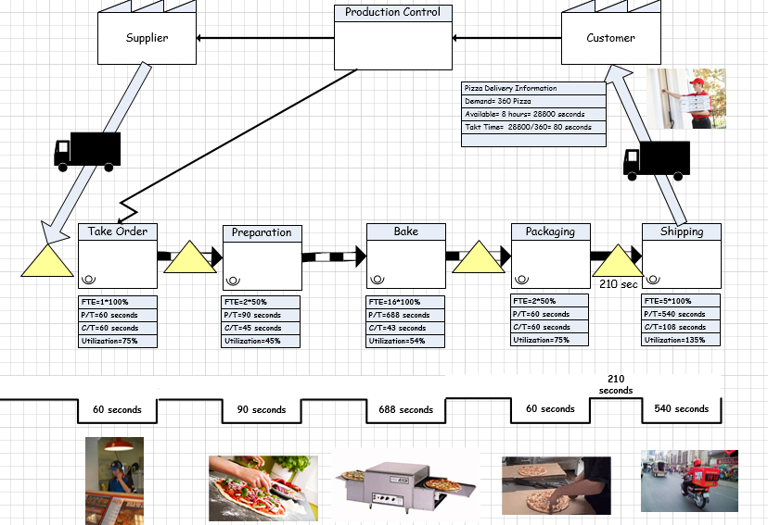
VSM

Slide 37
Define Objectives – Team Charter
Develop a team charter
Problem
Goal statement
Project scope
Business case
Team roles
Milestones
Obtain formal project approval, including resources and time required to complete project

Slide 38
Problem Statement
Define the problem precisely and concisely
Describe the current pain in the customers’ minds
Information specific to the current issue
Clearly states: WHAT, WHEN, WHERE, and TO WHAT EXTENT

Slide 39
Good/Bad Problem Statements
Example of a Bad Opportunity or Problem Statement: Product delivery needs to be improved. There have been many customer complaints about deliveries from the Dallas Plant. Employees surveyed confirm deliveries have not been satisfactory. Improving the process will increase profit and reduce complaints.
Example of a Good Opportunity or Problem Statement: In September, 70% of products shipped were late (what). Over the last 6 months (when), data from our customer base show products shipped to our West Coast customers (where) were late 75% of the time, but only 9% of others customers experienced problems. In September, the 30 late shipments (extent) to the West Coast were worth $790,000.

Slide 40
Define Phase – Project Charter Example
Problem/Goal Statement
Scope
Problem: Customer experience at CoffeeBrew is currently unsatisfactory at 13% below target level, 85% due to high cycle times for both walk-in and drive-through customers. This leads to lower-than-desired same-store sales (-1.2%), total revenue growth (-1.5%) and profitability (-.5%).
Goal: To improve customer satisfaction to at least 85% through reducing cycle time to below 8 minutes for walk-in and below 5 minutes for drive-in customers. This will increase operating measures for same-store growth above 5%, total revenue growth above 9%, and net profit margin above 9%
In Scope:
Internal store process and equipment
Out-of Scope:
Human resources pay and benefits
Real estate and facilities transactions
Regional bean roasting process
Decision rights:
Six Sigma Team must go through store managers to make process changes
Alonzo Bean will be accountable for making cross store and platform decisions
Finance team will be consulted about large
expenditures
Financial Impact
Gate Review Schedule
Increased turnover of bakery products
Reduced food disposal costs
Reduced sourcing and supplier costs
Increased per-customer order amount
Increase in same-store sales, revenue and profitability
Increase in net profit margin of entire chain
Tollgate Scheduled Revised Complete
Define: 09/26/11 - 10/03/11
Measure: 10/03/11 10/05/11 10/17/11
Analyze: 10/24/11 10/31/11 11/02/11
Improve: 11/16/11 11/16/11 11/21/11
Control: 11/21/11 11/23/11 11/28/11

Slide 41
Define Phase – Project Charter Exercise
With your team take 10 minutes to develop a project charter that includes:
Project Name:
Problem Statement:

Slide 42
Define Phase – Project Charter Example
Project Name: Speedy Pete
Problem Statement: Delivery time exceeds customers expectations 10% of the time.
Goal: Reduce Pizza Delivery to so 95% of all pizza’s are delivered with 29 minutes or less.

Slide 43

Measure
Tollgate
Define
Tollgate

Slide 44
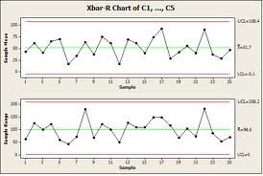
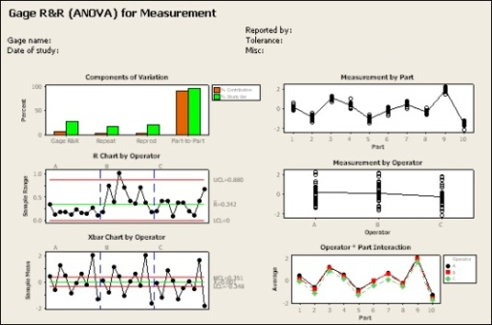
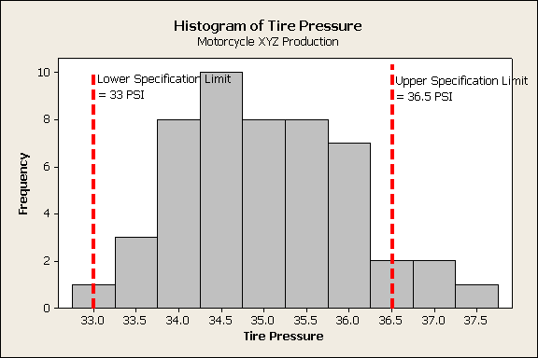
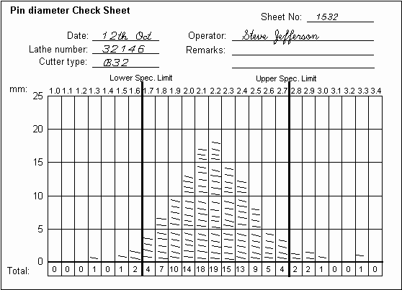
Measure Phase
Plan
Do
Study
Adjust
M
Collect baseline data
Validate measurement system
Calculate process capability
Continue collecting data
Confirm VSM data

Slide 45
We cannot improve that
which we do not measure.

Slide 46
Measure Phase - Tollgate Questions
Can the CTQCs be objectively measured? Has the success target been determined - in customer terms?
Have potentially significant process inputs (Xs) been identified for further screening?
Has a data collection plan been developed for the process output(s), or CTQC(s), and those process inputs which may be deemed to be significant?
Is the Measurement System capable of providing valid and reliable values with an acceptable degree of error?

Slide 47
Measure Phase – Tollgate Questions
What is the baseline performance (capability) of the process?
Are the relevant metrics visible and widely accessible? Are there any opportunities for "Quick Hits" (Kaizen Blitzes or Rapid Improvement Events)?
If the process is not capable, have containment actions been implemented to prevent customers from experiencing defects?

Slide 48
Measure Phase – Tools Applied
Data Collection
Measurement System Analysis
Histograms
Trend Charts
Control Charts
Process Capability

Slide 49
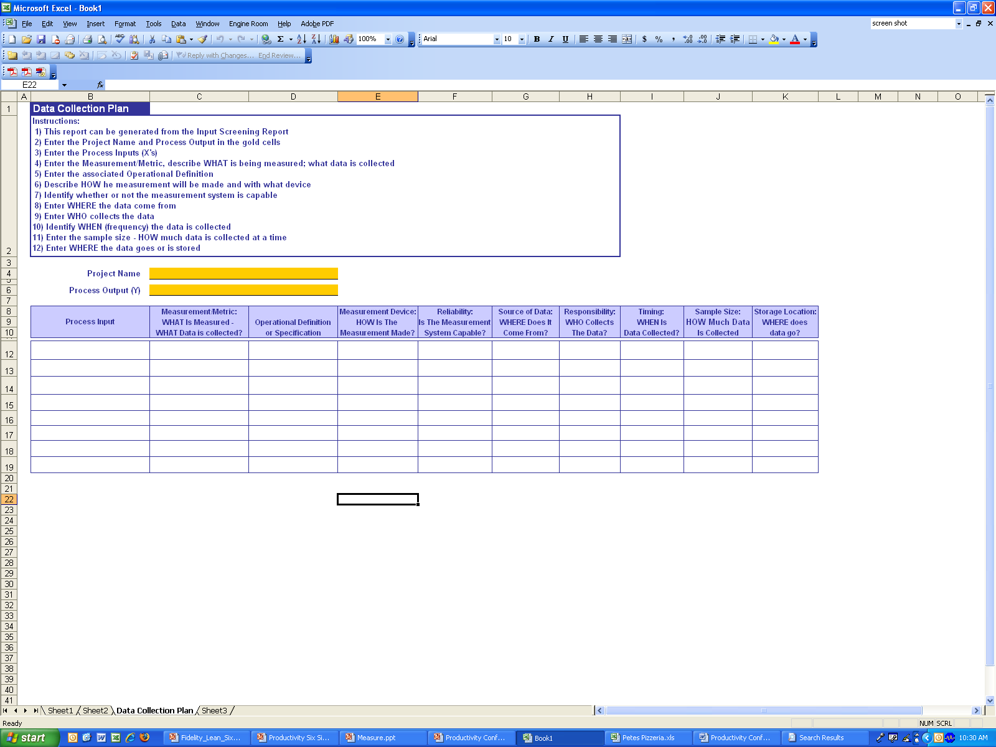
Measure Phase – Data Collection
Can inputs be objectively measured?
How will you collect data on these variables?

Slide 50
Measure Phase – Baseline Data
Attribute Data
Usually discrete measurements; sort or count items based on attributes, such as the presence/absence of defects, quality perceptions, occurrence of an event
Number of students in a class, number of defective gears in a manufacturing plant, customer satisfaction rated on a scale of 1-5
Variable Data
Continuous measurements, can take on infinite values within any two fixed points
Heights of all the students in a class, Measurement of time, speed of a vehicle

Slide 51
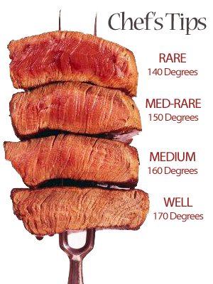
Measure Phase – Operational Definitions
Should be clear, unambiguous, observable standard of acceptance
If possible, operational definitions should be measurable

Slide 52

Measure Phase – Operational Definition Exercise
With your team take 5 minutes to develop an operational definition for “total pizza delivery time.”
__________________________________________________________________
What is a defect?
__________________________________________________________________

Slide 53
Measure Phase – Op Def
With your team take 5 minutes to develop an operational definition for “total pizza delivery time.”
Total Pizza Delivery Time = From the time the phone is answered to the moment the delivery person knocks on door.
What is a defect?
Defect = Pizza Delivery > 29.0

Slide 54
Measure Exercise
With your team take 10 minutes to develop a data collection plan for 3 inputs into the process of making and delivering pizza.
Project name- Pete's Pizza
Process output (y)- Total order time
Process Input | Measurement Metric: What is measured? What data are collected? | Operational Definition or specification | Measurement Device- How is measurement made? | Reliability- Is the measurement system capable? | Source of data- Where does it come from | Responsibility- Who collects data? | Timing- When are data collected? | Sample size- How much data are collected? | Storage location- Where do data go?
Preparation | Cook time |  | Timer | Yes | Cooking equipment | Cooks | 4 pm- midnight, 7 days a week for a month | 240 | Store owner Antonio
Waiting | Wait time | Cooked pizzas waiting in packages to be delivered to customer, due to lack of drivers | Manual | No | ------- | Cooks | 4 pm- midnight, 7 days a week for a month | 240 | Store owner Antonio
Delivery | Travel time | Time elapsed between putting the packaged pizza into car and handing it to customer | Manual | No | ------- | Drivers | 4 pm- midnight, 7 days a week for a month | 240 | Store owner Antonio
Distance | Miles | Miles covered from pizza shop to customer home/business | Car dashboard | Yes | ------- | Drivers | 4 pm- midnight, 7 days a week for a month | 240 | Store owner Antonio

Slide 55
Pete’s Pizzeria Business Case
Before Pete offered the promotion he knew he needed to collect data from his drivers to verify the delivery promise of 29 minutes or less.
Pete decided to check deliveries over a full month by taking a random sample.

Slide 56
Pete’s Pizzeria Business Case
During each hour of business, he randomly selected a phoned-in order and carefully measured preparation time and the time the completed order had to wait for an available delivery person. Pete would then go on the delivery to accurately measure the delivery time.
At the end of the month, Pete had collected 240 samples.

Slide 57
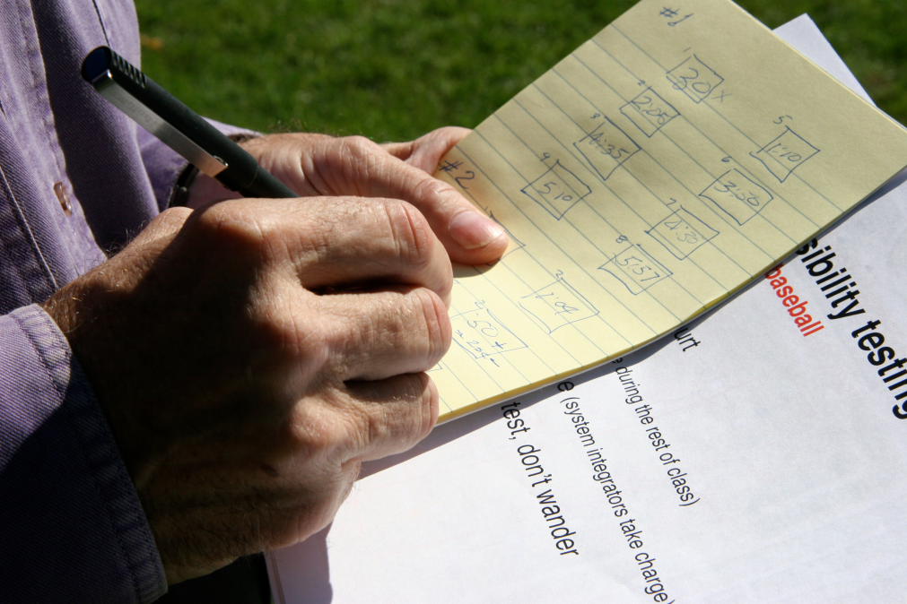
Measure Phase – Data Collection Reflection
Reflection: Is Pete’s data collection plan capable of providing valid and reliable values with an acceptable degree of error?
What would you change?

Slide 58
Measure Phase – Baseline Performance
Understand the baseline performance of the process
Quantifies the gap between current performance and required performance
To generate a baseline performance of the process, start with output measurements (defects for customers) and then push upstream to inputs

Slide 59
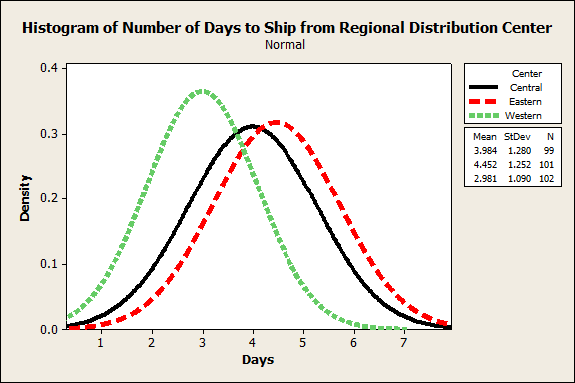
Measure Phase – Baseline Example

Slide 60
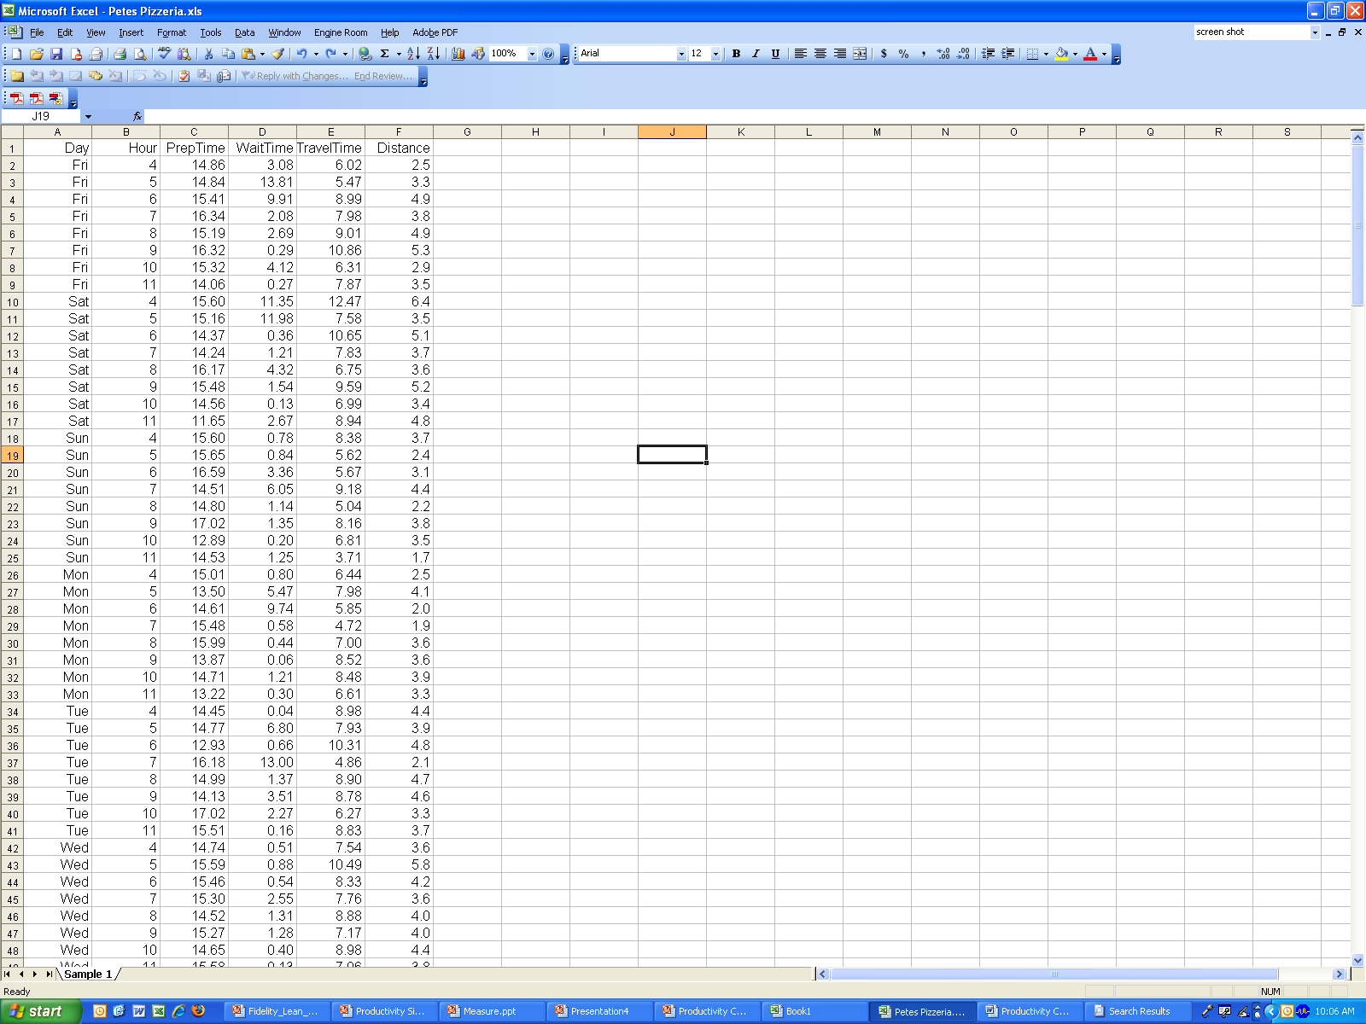
Measure Phase - Baseline Example
Open Excel file Data for Petes Pizzeria.xls

Slide 61
Measure Phase – Baseline Example
Calculate total time to deliver pizza.
Mean: ________
Std Deviation: ________

Slide 62
Measure Phase - Variation
-
-3s
-2s
-1s
x
1s
2s
3s
68%
95%
99.7%

Slide 63
Measure Phase – Baseline Example
Develop a Histogram of total time to deliver pizza.
Add a column for:
Total Delivery Time = Prep Time + Wait Time + Travel Time
Select Total Time Column
Select Histogram

Slide 64
Measure Phase - Histogram

Slide 65
Measure Phase – Baseline Example
Calculate number of late deliveries:
# of late deliveries___________
% of late deliveries __________
(Hint: Number of late deliveries is an attribute measurement. Was the pizza delivered late? Yes or no. Remember, pizzas delivered after 29.0 minutes are considered late.)

Slide 66
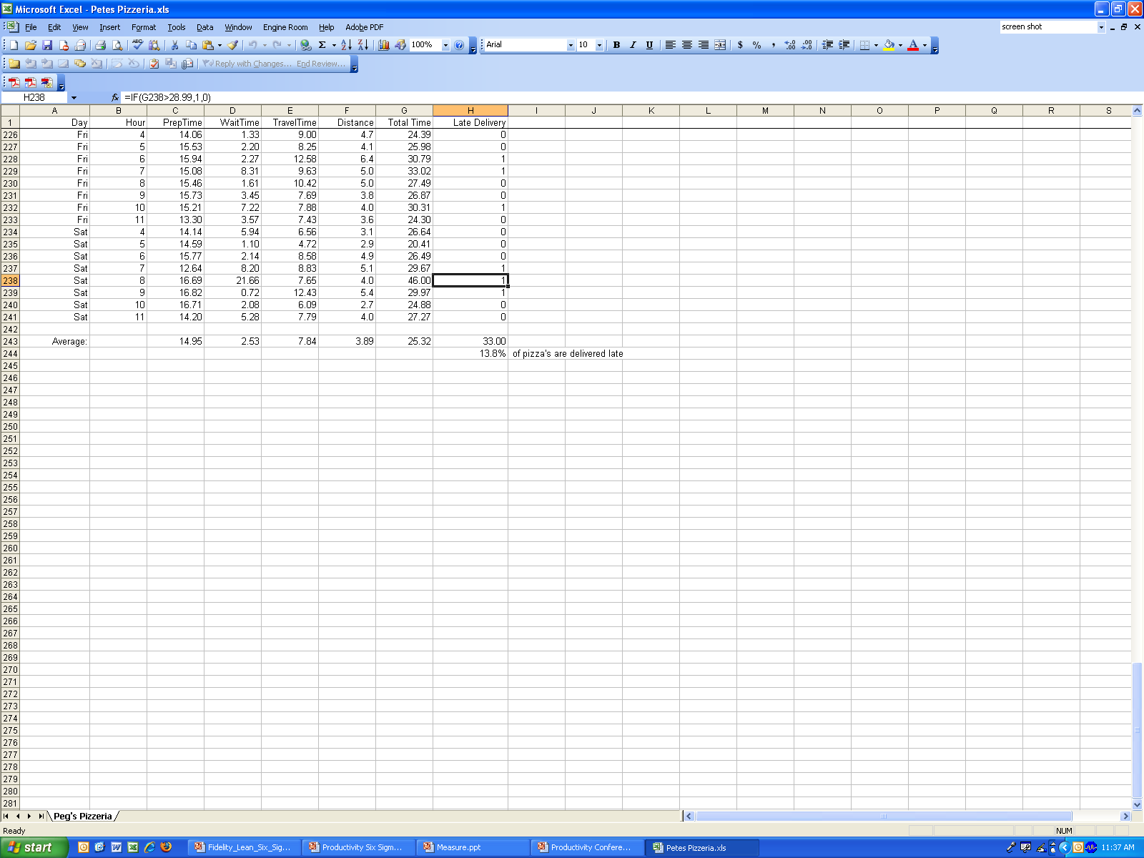
Measure Phase – Late Deliveries

Slide 67
Measure Phase – Control Charts
Gives one an understanding of process behavior
Helps to reduce process variability
Control Charts: Provide a basis to evaluate the stability of the variation and the mean
Control limits help us distinguish special causes (to be reduced for improving the process) from random variation, based on the data gathering and analysis strategy

Slide 68
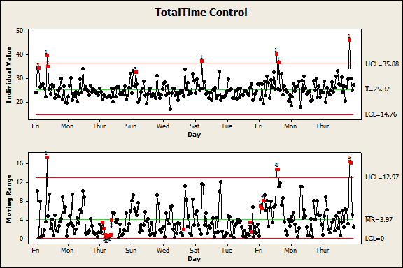
Measure Control Chart
Process statistically out of control with several points outside control limits in the Mean Chart and Moving Range Chart
Special cause on Fridays and Saturdays

Slide 69
Measure – Sigma Level or DPMO
Process Capability
Sigma level based on number of defects that occur in every million opportunities
Number of process standard deviations, between the mean and the closest specification for a process output
DPMO= (Number of Defects x 1,000,000) / ((Number of Defect Opportunities/Unit) x Number of Units))
Process Capability
Cp- Process potential, determines spread of the process
Cpk- Process centering between the specifications

Slide 70
Measure: Quick Conversion
Process Sigma σ | DPMO Defects Per Million Opportunities | Cpk (process capability) | Yield
1.0 | 691,500 | 0.33 | 31.0%
2.0 | 308,500 | 0.67 | 69.2%
3.0 | 66,800 | 1.00 | 93.32%
4.0 | 6,200 | 1.33 | 99.379%
5.0 | 230 | 1.67 | 99.977%
6.0 | 3.4 | 2.00 | 99.9997%
Pete’s Pizza

Slide 71


Measure Phase – Sigma Level & VOC
6 σ
~35,000-50,000 lost items per million
Less than ½ failure per million flights
3.5 σ
Sometimes variation is unimportant and other times it can be very serious.

Slide 72
Measure Phase – Calculating Process Capability
Start here
N
Is your process in Statistical Process Control?
Y
Attribute
Attribute or Continuous Data?
Describe Process Performance, NOT Capability
Use:
Sigma, DPMO, Yield %
Continuous
Or:
non-Normal Capability
Analysis
Normal or non-Normal?
non-Normal
Normal
Use:
Sigma, DPMO, Yield %
Process Potential
Potential
Capability
(short-term)
Observed Potential
Observed
Capability
(long-term)
C_{p}
C_{pk}
P_{p}
P_{pk}

Slide 73
Measure Phase – Analyzing a Process: Scenarios
In Control? | Capable? | Possible Actions
Yes | Yes | Reduce cost, improve quality, innovate, simplify, promote
Yes | No | Re-center or reduce variation, simplify, redesign, inspect as a last option
No | Yes | Eliminate special causes
No | No | Eliminate special causes, then re-center or reduce variation, simplify, redesign
Re-center => change setpoints, rebalance, reduce NVA, reduce WIP, modify capacity
Reduce variation => standard work, 5S, improve flow/layout, reduce variation of inputs

Slide 74

Measure Phase - Reflection
How does the amount of late deliveries compare to Pete’s breakeven analysis for profitability?
Would you offer the delivery guarantee?

Slide 75
Measure Phase – Project Charter Update
With your team, take 5 minutes to add the following to your project charter:
Deliverables
Goals/Metrics

Slide 76
Analyze Phase

Slide 77
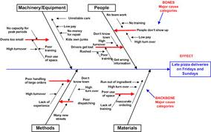
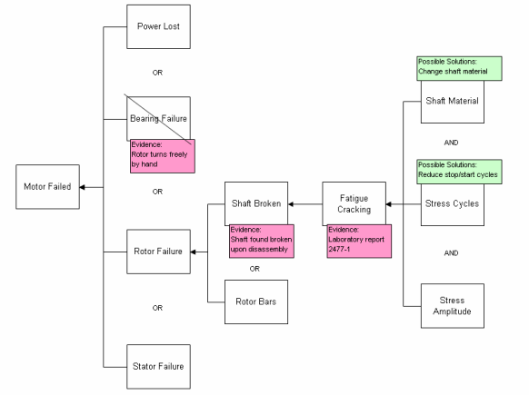
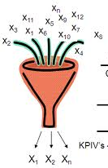
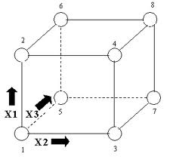
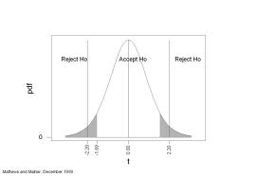
Plan
Do
Study
Adjust
A
Display theories about potential causes
Create a Cause Map
Validate critical X’s
Conduct Experiments
Conduct hypothesis tests

Slide 78
Analyze Phase – Tollgate Questions
What are the significant inputs (Xs) affecting the output of concern (also known as Ys or CTQs)?
What are the target levels of those inputs (Xs) that optimize the output of concern?
Are the input processes stable and capable?
What are the underlying sources of process variability?
Have alternate methods been validated as effective?
Are the interactions between inputs identified, understood and optimized?

Slide 79
Analyze Phase – Tools Applied
For identification of potential Xs:
Cause and Effect matrix
Pareto
Failure Mode Effects Analysis
For statistical testing on Xs, analyzing and verifying:
ANOVA
T-test, Z-test, Chi-square
For modeling and optimization
Regression
DOE

Slide 80
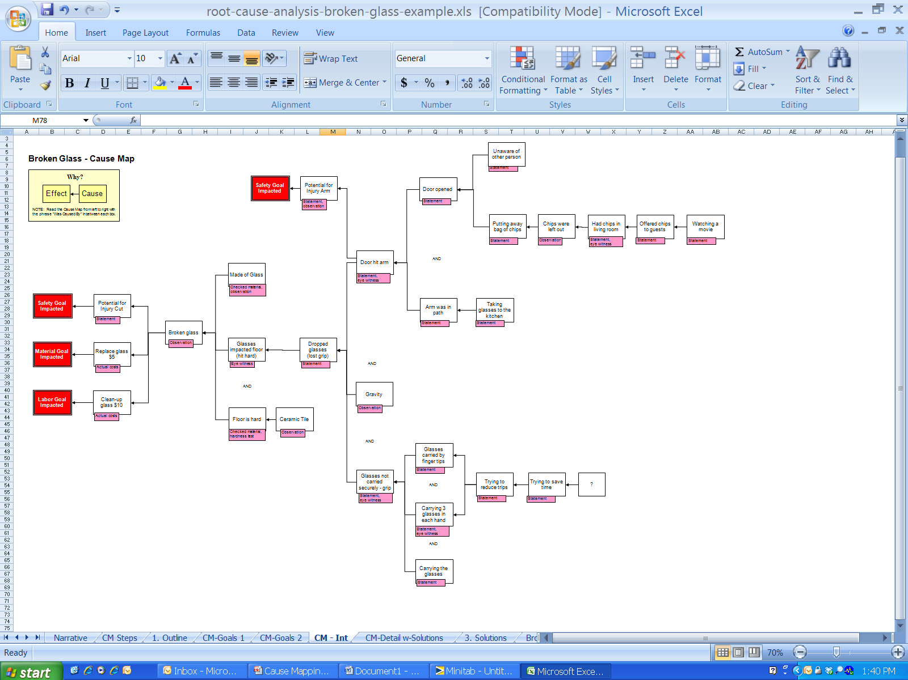
Analyze Phase – Root Cause Analysis
Cause-and-effect explains why a particular incident, problem or event occurred. The map builds backwards through time by asking “why” questions. A cause and effect map creates a clear visual depiction of the current state.

Slide 81
Analyze Phase – Cause & Effect Map
With your team, take 15 minutes to identify the inputs that impact the response variable targeted for improvement.
X_{1a}
X₁
X_{1b}
And/or
Y(_______)
_____
X2a
X2b
X₂
X2b
And/or
X3a
X₃
X3b

Slide 82

Analyze Phase – Cause & Effect Map
With your team develop a cause map with identified problem statement.
Drivers caught up in traffic
Hours and day of delivery
Pizza waiting for drivers after being packaged
Drivers lost on their way
Time between customer ordering a pizza and pizza getting delivered to the customer >29 mins.
And/or
High turnover rate among drivers
College kids as drivers
____
_____
Insufficient number of drivers
And/or
Extremely long distance to be traveled for delivery

Slide 83
Analyze Phase – Validate Causes

Slide 84
Analyze Phase – Validate Causes
How can we stratify the data set to see where potential problems exist?
Day of the Week
Prep Time, Wait Time, Travel Time
Driver
Cook
Type of Pizza Ordered

Slide 85
Analyze Phase – Pareto Chart
80-20 rule
Separating the "vital few" from the "trivial many“
Relatively small number of issues accounting for an overwhelming share of the defects.

Slide 86
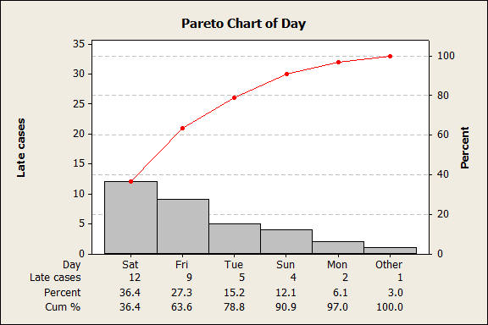
Analyze Phase – Pareto Example
Weekends accounting for majority of late delivery

Slide 87

Analyze Phase – Return to the C&E Map
With your team spend 30 minutes analyzing the Pete’s Pizza data set by day of the week and process step.
Update the Cause Map with data

Slide 88
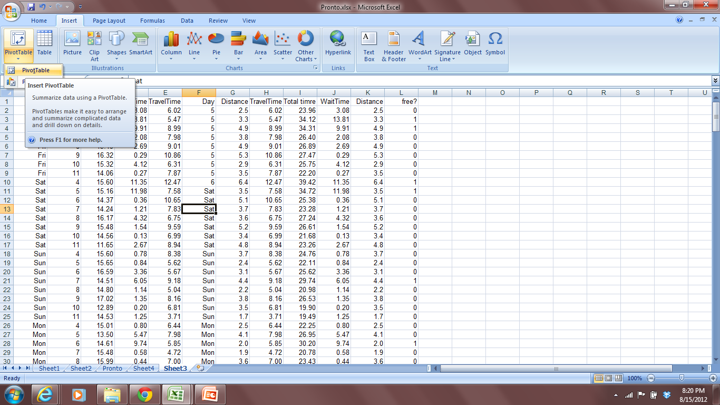
Data Stratification – Pivot Table
Step 1

Slide 89
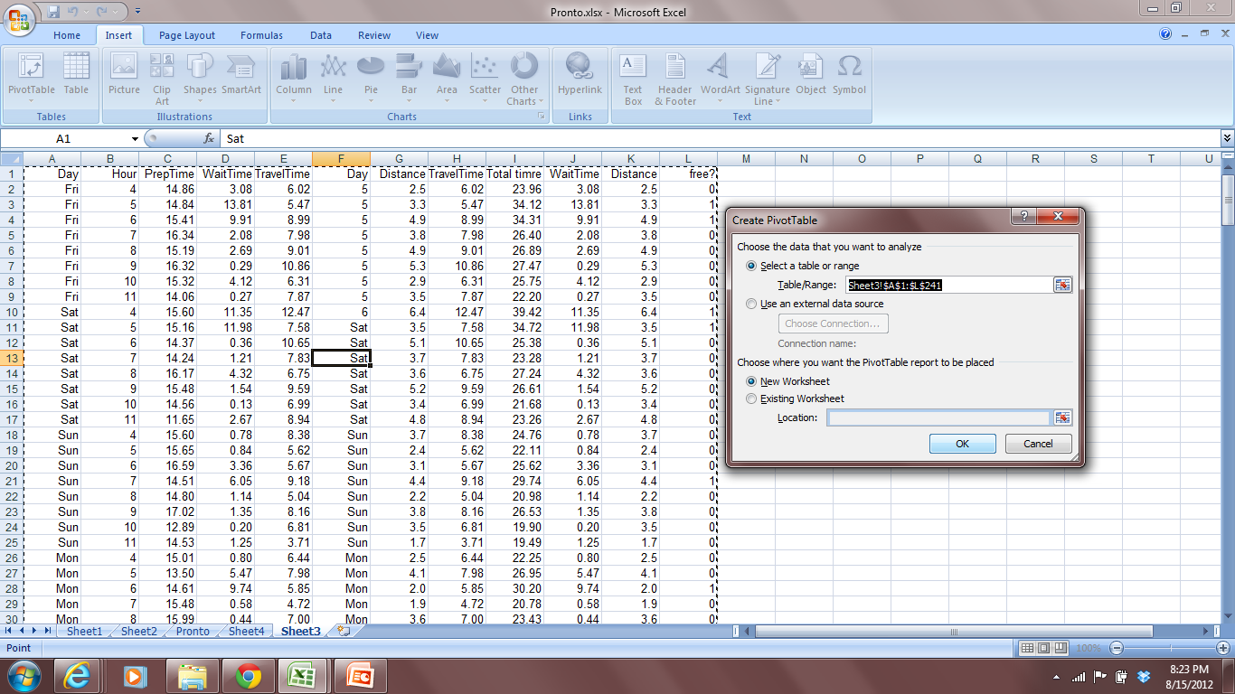
Data Stratification – Pivot Table
Step 2

Slide 90
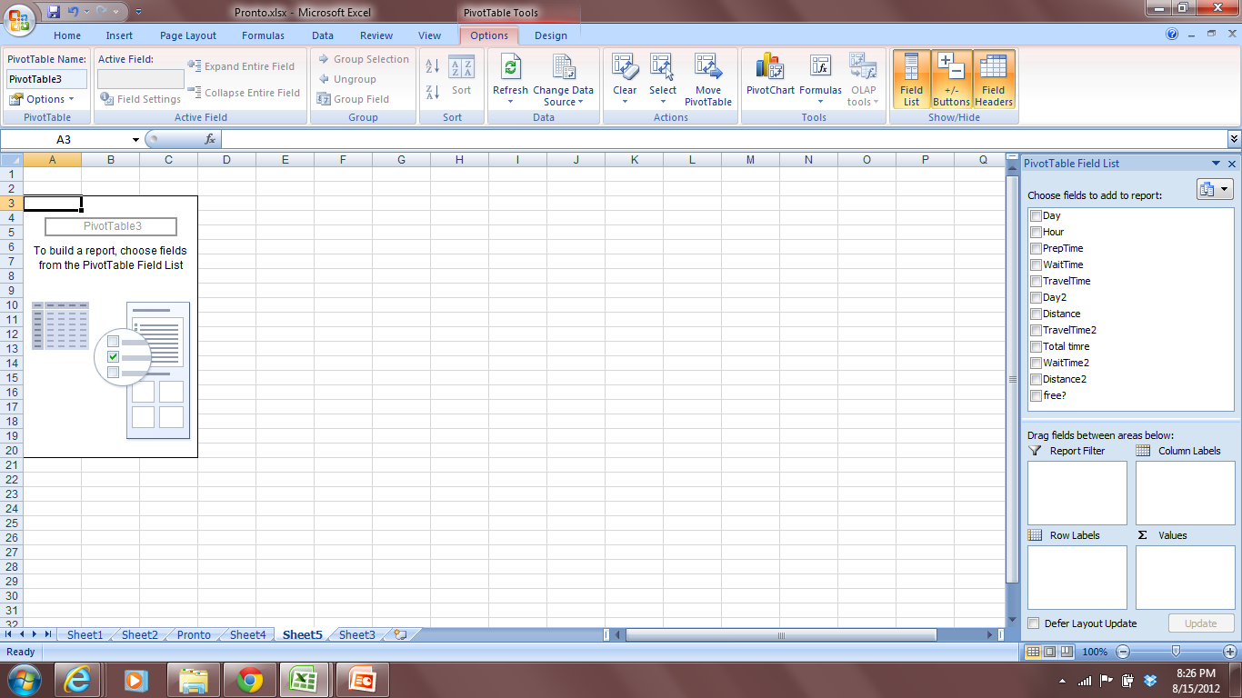
Data Stratification – Pivot Table

Slide 91
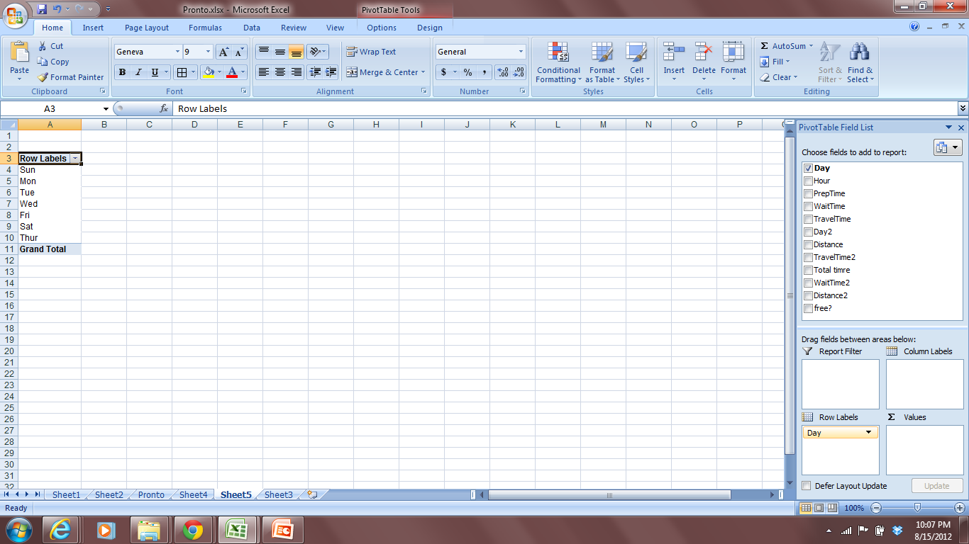
Data Stratification – Pivot Table
Step 3
We want to stratify the data by day of the week. Drag and drop Day from fields on the top to Row Labels at the bottom

Slide 92
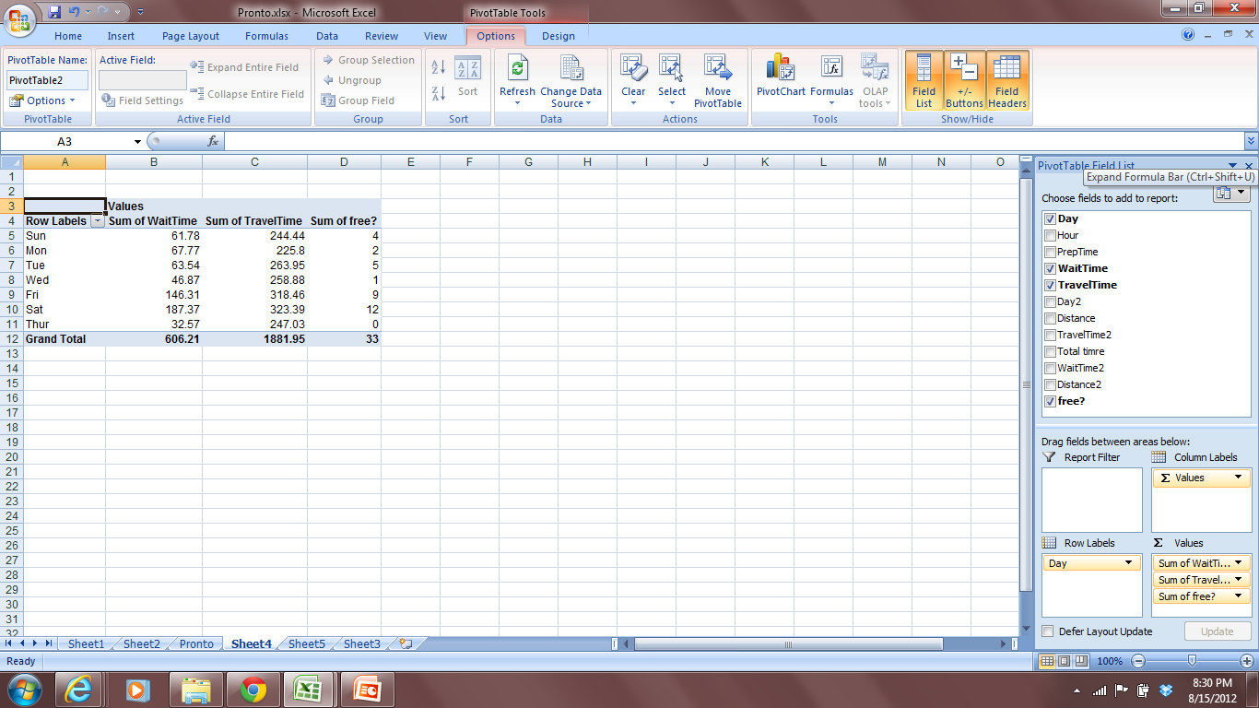
Data Stratification – Pivot Table
Step 4
We want to find out the wait time, travel time and number of free pizza delivered on these days. Drag and drop Wait time, Travel time and Free from the fields list to Values at the bottom

Slide 93
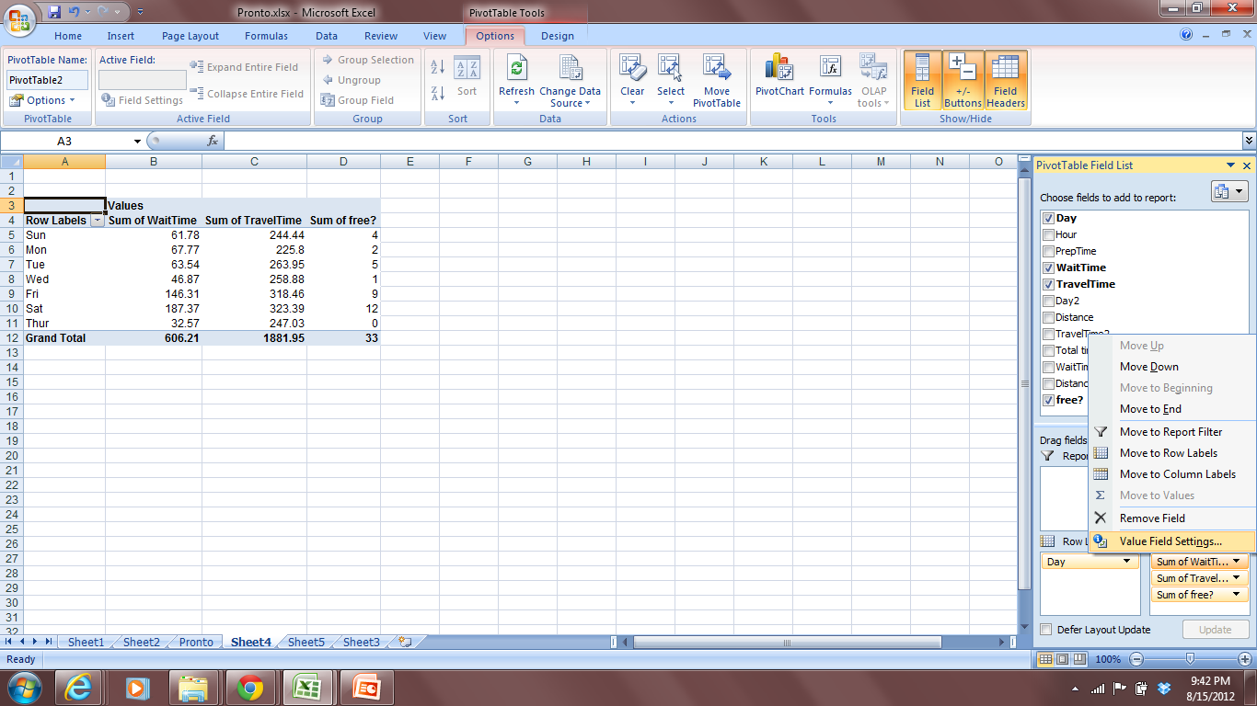
Data Stratification – Pivot Table
Step 5
Sum of Wait Time, Sum of Travel time do not make much sense. Need to change it to something sensible. How about average of wait time and average of travel time?

Slide 94
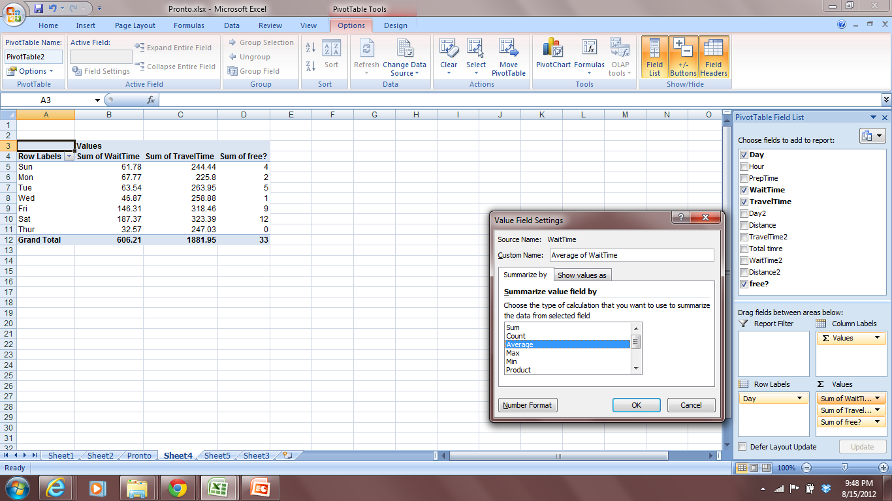
Data Stratification – Pivot Table
Step 5

Slide 95
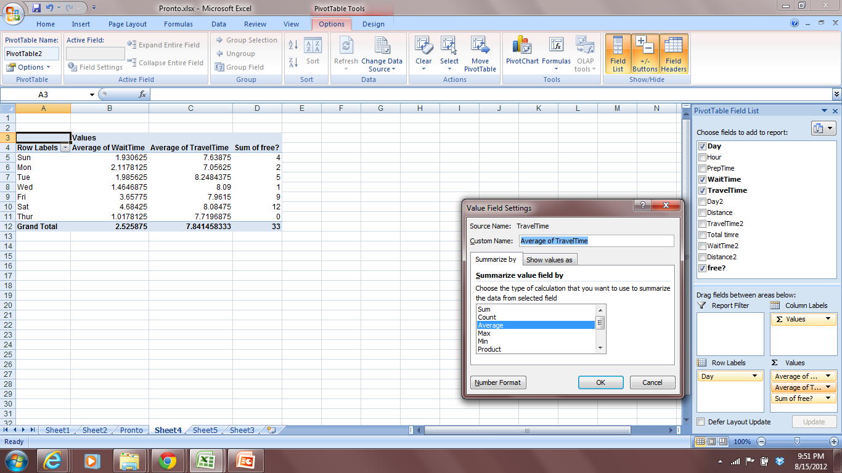
Data Stratification – Pivot Table
Step 5

Slide 96
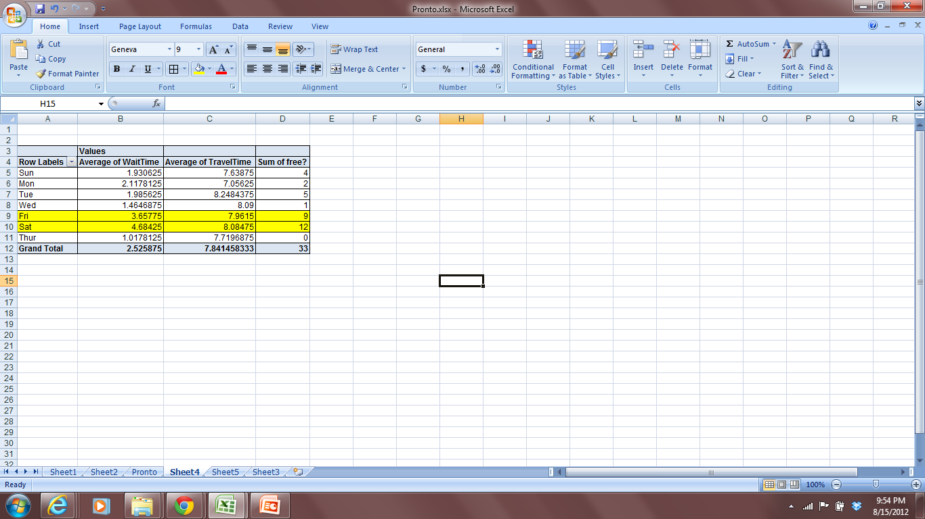
Data Stratification – Pivot Table
Final Step- Analysis
Cause of concern

Slide 97
Analyze Objective – Significant X’s
Determine the significant inputs (Xs) affecting the response variable, or Y.
Pete’s Pizzeria Significant Xs for pizza delivery time:__________

Slide 98
Analyze Objective – Additional Significant X’s
Interviews and direct observation reveal:
15% of the time drivers call in sick on the weekend
8% of the time drivers get lost
Wrong Address 4% of the time

Slide 99
Improve Phase

Slide 100
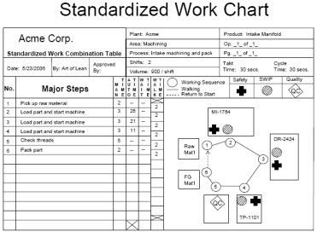
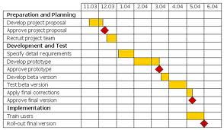
Improve Phase
Safety Quality Leadtime, Cost
A ++ + ++
B + ++ + +
C + +++ + ++
D ++ ++ + ++
E ++ + +++ +
Plan
Do
Study
Adjust
I
Brainstorm Potential Countermeasures
FMEA =
Severity x
Occurrence x
Detection
Verify Countermeasures - Standardize
Pilot Solutions
Assess Risk

Slide 101
Improve Phase – Tollgate Questions
What improvement actions are necessary to achieve targeted performance levels?
Has a process been established to track implementation with defined responsibility and target dates?
Are there any obstacles to improvement? Unintended consequences? Indirect effects?
How might the system push back?
Is the Six Sigma team functioning as effectively as possible?
Have improvement action alternatives been evaluated for relative attractiveness?

Slide 102
Improve Phase – Tools Applied
For process change
Design for Six Sigma
For comparison
Benchmarking
For prioritizing areas of improvement
Failure Mode and Effects Analysis
For selecting solution
A3 Report
For eliminating waste
Lean Method/Continuous Flow/Cellular Processing/Standard Work
For keeping a track of the improvements within organization
Corrective Action Matrix

Slide 103
Improve Exercise - Countermeasures
With your team take 10 minutes to develop a list of countermeasures for the causes identified in the case.

Slide 104
Improve Phase – Solution Prioritizer
The steps involved in prioritizing and selecting a solution are as follows:
Establish rating criteria - Factors upon which the potential solutions will be evaluated such as strategic fit, investment, technical feasibility, development time, etc.
Weight the criteria - What is the importance of each of the criterion? Can be rated on a scale of 1-10
Establish criteria rating descriptions - Define an achievement level for every criterion corresponding to each level of allowable rating
Rate each solution against the criteria, typically the ratings are on a scale of 1 to 5, with 1 meaning the solution does not satisfy the criterion and 5 meaning the solution fully satisfies the criterion
Sum and rank order the ratings. The solution with the highest sum total is the one most likely to succeed based on the criteria, vote in case of a tie

Slide 105
Improve Phase – Evaluate Risk
FMEA: A tool used to prioritize potential defects based on their severity, expected frequency
Severity The seriousness of a failure mode.
Occurrence The likelihood that a given failure mode will happen
Detection The likelihood that a given failure mode will be detected if it occurs, prior to release to a customer y, and likelihood of detection
Overall risk represented by Risk Priority Number, or RPN

Slide 106
FMEA – Pete’s Pizza
FMEA
Process Name: Free Pizza
Process Number: SBT 445
Date: 08/11/2012 Revision Level: 1.2
FAILURE MODE | A) SEVERITY | B) OCCURRENCE Probability | C) DETECTION Probability | RISK PRIORITY NUMBER | ACTION TO IMPROVE | REVISED VALUES
 | Rate 1-10 | Rate 1-10 | Rate 1-10 | RPN
 | 10=Most Severe | 10=Highest Probability | 10=Lowest Probability | AxBxC |  | A | B | C | RPN
1) Drivers unavailable to take out orders | 8 | 8 | 4 | 256 |  |  |  |  | 0
2) Drivers stuck up in traffic | 6 | 6 | 7 | 252 |  |  |  |  | 0
3) Long distance to be covered | 3 | 3 | 2 | 18 |  |  |  |  | 0

Slide 107
Improve Phase – Corrective Action Matrix
Used by problem-solving teams to keep track of WHO is doing WHAT - by WHEN
A template:
Index
1. Reference Number- Tracking number that may also be tied in with a project priority list, or linked to a numbered Cause & Effect (Fishbone) chart.
2. Action - Summary of the improvement action being implemented.
3. Champion - Person with primary responsibility to implement the action.
4. Target Date - Due date for implementation.
5. Effectiveness - Often overlooked: When the action is implemented, how much of the problem will be corrected.
6. Current Status - Provides details of current status to identify any risk of missing the target date.

Slide 108
Control Phase

Slide 109
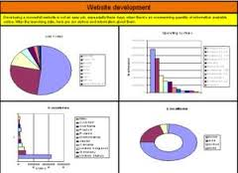

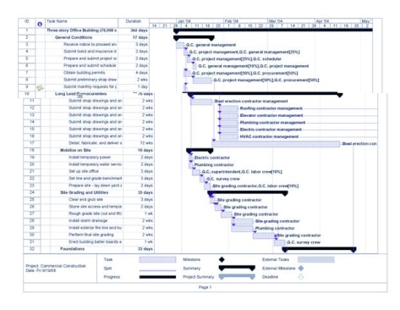

Control Phase
Plan
Do
Study
Adjust
C
Measure Key Inputs
Knowledge Management
Project Closeout
Daily system validation

Slide 110
Control Phase – Tollgate Questions
Do we have a control plan?
What metrics are we going to collect on an ongoing basis? How will those metrics fit into a dashboard?
Have we revised the FMEA post pilot? How quickly can we detect problems with the process?
Do we know if the process is stable after the improvements?
What standards have we created? Have we documented the standards?
Have we revised all procedures?

Slide 111
Control Phase – Tollgate Questions
Have we engaged the process owner?
How will we conduct the handoff to the process owner?
How will we manage change?
How should we document the gained knowledge?
Who do we have to communicate? When and How?
Can some best practices be identified? Can those be teed up for future adoption?
Can we find future projects based on issues we did not address here?

Slide 112

Achieving Operational Excellence
(Sustained behavior)
3. Leader Standard Work
(Improvement)
2. Standard (Visual)
Accountability
Process
Focus!
(Frequent focus on
process health)
1. Visual Controls
Creating a Lean Culture, David Mann

Slide 113
Achieving Operational Excellence
Tactics
Third tier (10-15 min)
VS manager and staff
Shift changeover or into shift
Coverage, issues, prior misses, assignments
Daily topics
Second tier (10-15 min)
Supervisor and team leaders
Shortly after start-up
Coverage, issues, prior misses, assignments
Daily topics
First tier (5-10 min)
Team leader and crew, at shift startup
Are people here, ready to work?
Daily topics
Strategies
Process
Results
Plan
Do
Study
Adjust
Value Stream
Plan
Do
Study
Adjust
A3
A3
A3
Plan
Do
Study
Adjust
Standard
Work
Poke
Yoke
5S/
Visual
Mgt.
A3

Slide 114
Control Phase – Create Visual Mgmt.
With your team, take 15 minutes and create one visual for a countermeasure selected
A board for Pete to review Key Performance Indicators

Slide 115
The battle for the customer is won not in the boardroom but in the laboratories, on factory floors, at service counters, and in computer rooms each and every day of the year.
David Upton, Harvard University

